Slide 1
Secured Insurance Framework Using Blockchain and Smart Contract
Afeefa K H
Roll No : 3
S4 MCA - A

Slide 2
Relevance of the topic
Traditional insurance policy settlement is a manual process that is never hassle-free.
There are many issues, such as hidden conditions from the insurer or fraud claims by the insured, making the settlement process rough.
This process also consumes a significant amount of time that makes the process very inefficient.
This whole scenario can be disrupted by the implementation of blockchain and smart contracts in insurance.
Blockchain and innovative contract technology can provide immutable data storage, security, transparency, authenticity, and security while any transaction process is triggered.
With the implementation of blockchain, the whole insurance process, from authentication to claim settlement, can be done with more transparency and security

Slide 3
Description of the project
Its primary goal is to use blockchain and smart contracts to ensure secure, insurance fraud-free transactions.
It is to be noted that it is supposed to be a framework for an insurance company
This framework covers client registration, insuring a policy, and refund settlement activities using blockchain technology, making the whole insurance system more robust.
The client will be able to register and issue a policy, claim, and refund with the help of their corresponding agent.
With the help of the corresponding agent, the information gets placed into the Ethereum private network.
The agent is fully responsible for submitting all client requests within the network.
When the transaction happens, the validators are responsible for validating the transactions.
The validators are previously selected and will validate transactions per the rules of the Proof of Authority algorithm

Slide 4
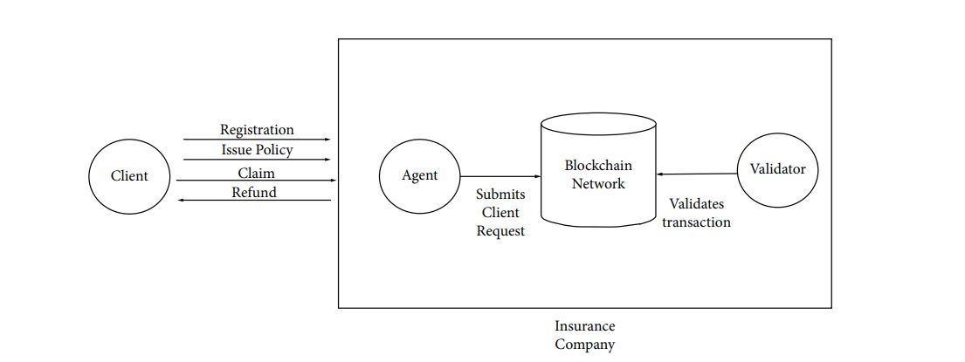
Figure 1 : Full System Diagram

Slide 5
Objectives of the study
The Objectice is to create an insurance ecosystem using blockchain technology
The objective of secured insurance framewrok using is to provide immutable data storage, security, transparency, authenticity, and security while any transaction process is triggered.

Slide 6
Existing System
Existing insurance systems have achieved a certain degree of automated processing. However, due to the lack of a single trusted source of state information of different transactions, they still suffer from performance bottlenecks.
The generic insurance systems require manual interactions across different transaction processes, hence resulting in slow processing, and lengthy payment settlement time.
Due to similar issues, the insurance industry is also facing the challenges of detecting claim frauds , which can otherwise be handled efficiently using blockchain-enabled smart contracts

Slide 7
Proposed System
The idea behind our model is to implement the processes of an insurance company as smart contracts, and place the contracts in a blockchain-enabled distributed platform, for both execution of the contracts and storage of the results.

Slide 8
Input and Output modules
Clients : The main character that is directly involved in the model is the client. He can register for the contracts, request insurance policies, submit claim requests, apply for a refund, and more with the help of their corresponding agent.
Agents : They control important features like policy issuing, policy initializing, and different client queries. The agent panel interface can control all the features, including looking into clients’ lists, the agency policy lists, the transaction history.
Validators : Responsible for verifying contract policies and transactions and storing the contracts in the ledger.

Slide 9
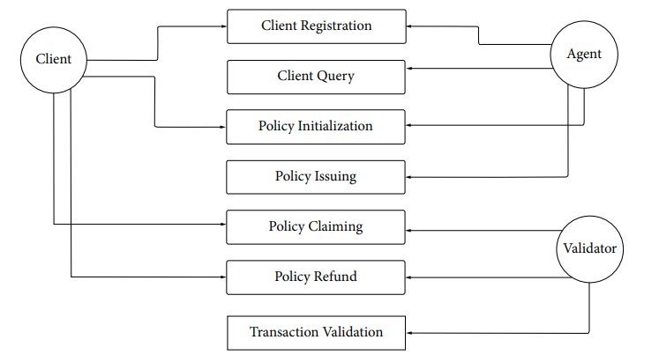
Methodology/System Design

Slide 10
Algorithm used
The framework uses the Proof of Authority (PoA) consensus algorithm to validate the transactions.
In the case of any faulty transaction request, the consensus algorithm acts according to and cancels the claim.

Slide 11
THANK YOU

